Slide 1
What are (stable) isotopes?
Two or more forms of an element that have the same number of protons but different numbers of neutrons, leading to different atomic mass.
Two types: radioactive and stable
Stable isotopes do NOT break down (decay) over time.
Stable isotope ratios are reported as delta (𝞭) values
in parts per mil (‰).

Slide 2
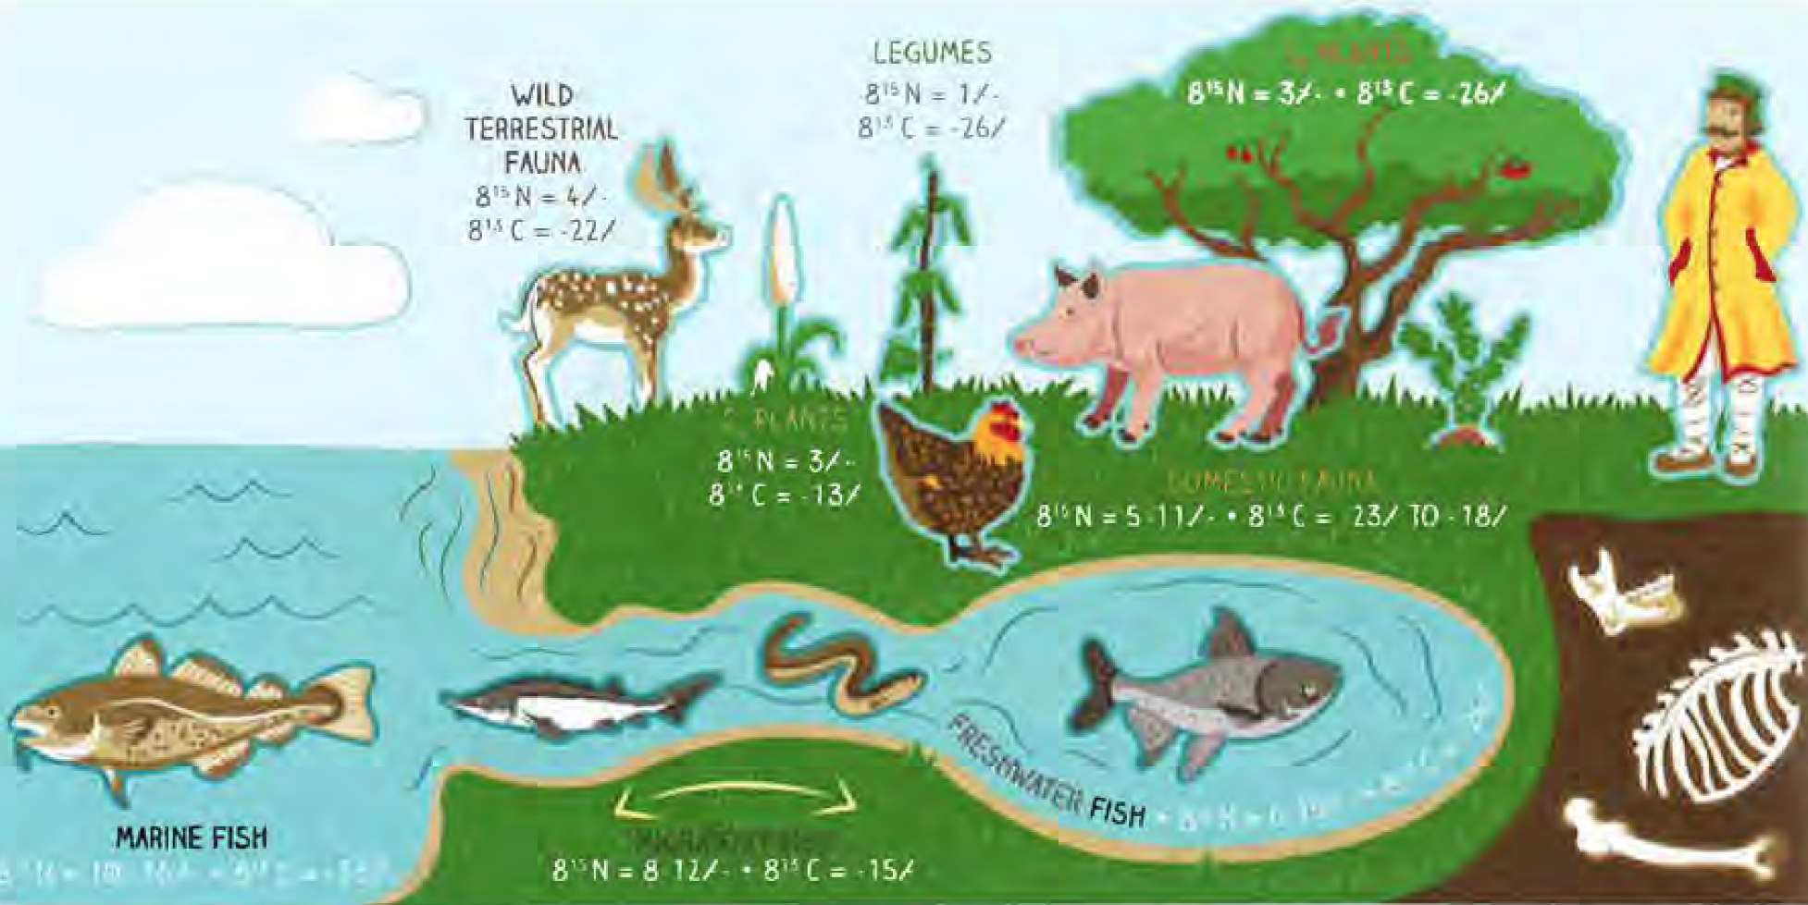
Where do stable isotopes come from?
Food and water that an animal consumes during its life leaves a chemical signature in its tissues (like bones and teeth)
Isotopes of elements like carbon (C), nitrogen (N), and strontium (Sr) found in animal remains at archaeological sites can tell us about:
Where animals were raised
What types of plants or animals they were eating
Carbon and nitrogen exist in the atmosphere as gases, which are absorbed by plants during photosynthesis and bacteria in the soil. Animals eat these plants, and absorb their carbon and nitrogen into their own bones and teeth.

Slide 3
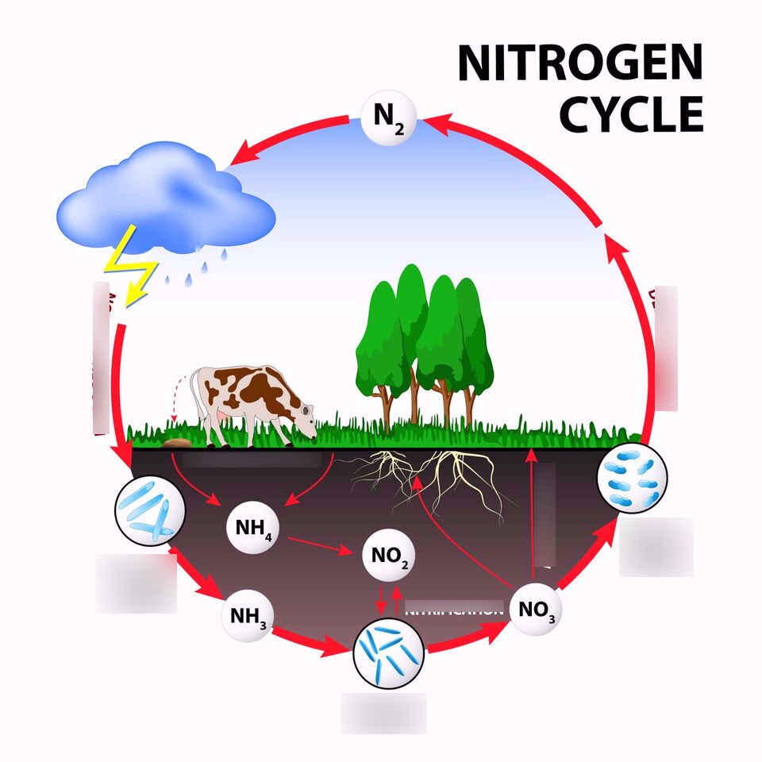
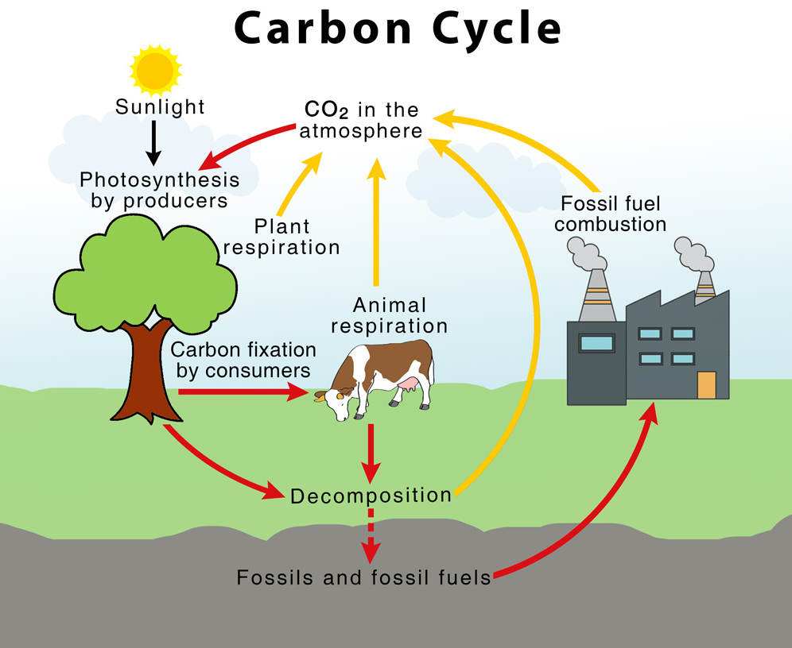
Where do stable isotopes come from?
Carbon and nitrogen exist in the atmosphere as gases, which are absorbed by plants during photosynthesis and bacteria in the soil. Animals eat these plants and absorb their carbon and nitrogen into their own bones and teeth.
Strontium isotopes are found in rocks. When rocks break down into soils, plants absorb some of this strontium into their tissues. Strontium isotope ratios vary from place to place, depending on the bedrock makeup of the local region.
Review carbon and nitrogen cycles with students, as well as photosynthetic pathways.
Review C3, C4, and CAM photosynthetic pathways; or remind students that different kinds of plants take in carbon in different ways.

Slide 4
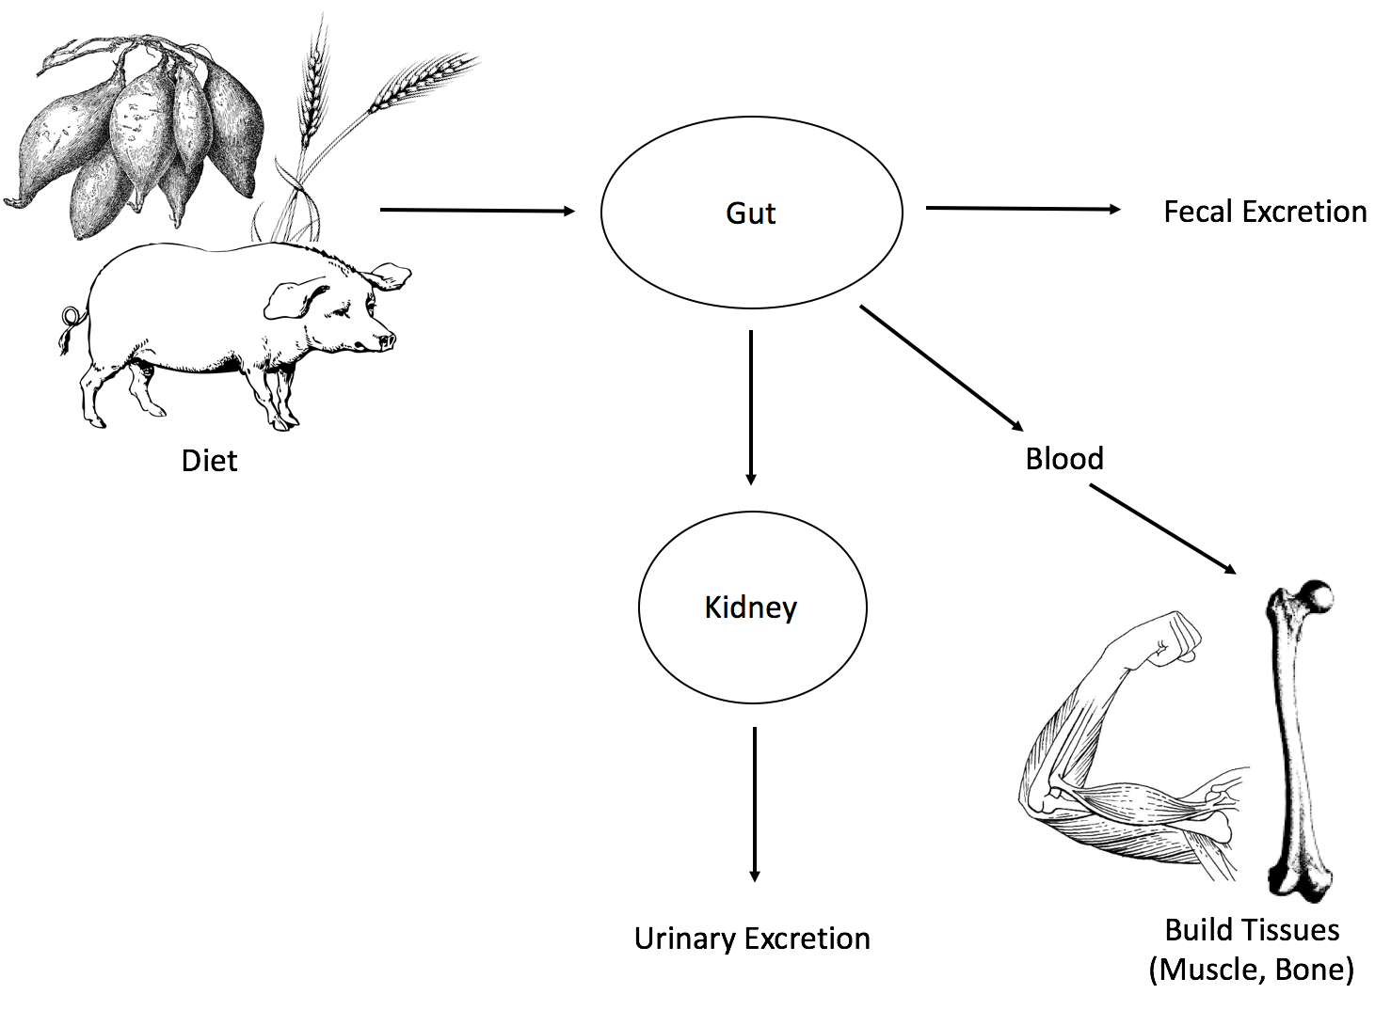
How do stable isotopes enter our bodies and the bodies of animals?

Slide 5
How do stable isotopes reflect diet?
Food and water that an animal consumes during its life leaves a chemical signature in its tissues (like bones and teeth)
Isotopes of elements like carbon (C), nitrogen (N), and strontium (Sr) found in animal remains at archaeological sites can tell us about:
Where animals were raised
What types of plants or animals they were eating
Carbon and nitrogen exist in the atmosphere as gases, which are absorbed by plants during photosynthesis and from bacteria in the soil. Animals eat these plants, and absorb their carbon and nitrogen into their own bones and teeth.

Slide 6
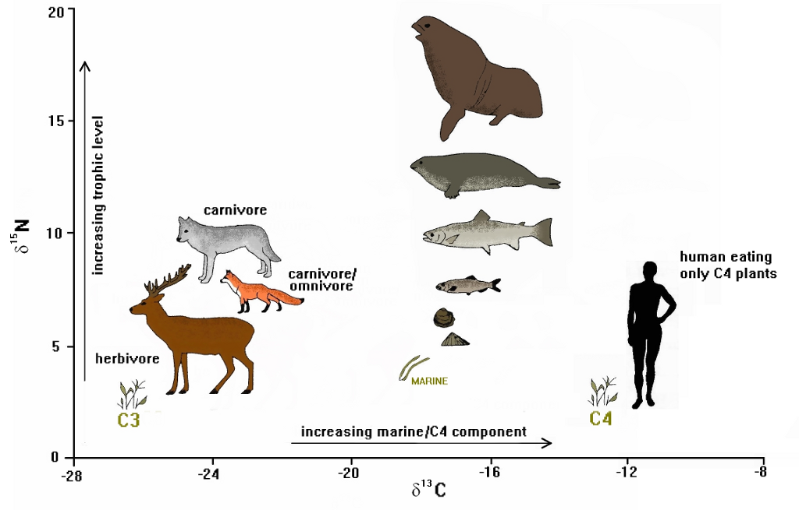
How do stable isotopes reflect diet?

Slide 7
How do stable isotopes reflect diet?
Stable carbon (C) and nitrogen (N) isotopes reflect different aspects of an animal’s diet.
Carbon tells us about the types of plants consumed by animals. Plants use one of three photosynthetic pathways: C₃, C₄, and CAM to create food for themselves. Each of these pathways creates a different carbon signature in the plant’s tissues.
Plants that use C₄ pathways (tropical plants and grasses) have higher (less negative) δ¹³C values. Plants that use C₃ pathways (woody plants) have lower (more negative) δ¹³C values.

Slide 8
How do stable isotopes reflect diet?
Nitrogen isotopes are used in diet studies to estimate the trophic level the animal was eating at – where in the food chain was the animal eating? Producers? Primary and secondary consumers?
Nitrogen isotopes also help us determine if the animal was eating from marine (salt water) sources and aquatic ecosystems, or freshwater sources.
Environmental factors like salinity, aridity, and vegetation cover also increase nitrogen values in animal bones and teeth.

Slide 9
What were cattle in and around colonial Charleston eating?
In the Upper Coastal Plain, cattle were living farther from the coastal areas in a dry environment of pine and oak forests. While some grasses (C₄ plants) were available for grazing, this area was surrounded by rivers and streams that supported abundant river cane (Arundinaria gigantea), a C₃ plant. Cattle often over-wintered in the Upper Coastal Plain of South Carolina and would eat river cane throughout the season.
In the Lower Coastal Plain, cattle were much closer to the coastal zone, and were foraging in estuarine regions, mud flats, and tidal creeks, areas that were full of plants that could tolerate high salinity (salt). These marshy areas were full of grasses, sedges, and herbs, all C₄ plants that would have been available to cattle for grazing. Most habitats in the Lower Coastal Plain would have been impacted by wind-blown salt spray coming from the coast.

Slide 10
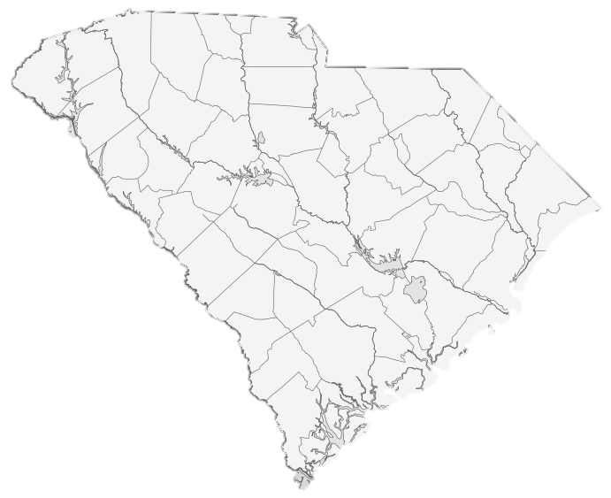
Lower Coastal Plain
Upper Coastal Plain
Charleston

Slide 11
10
9
8
7
6
δ¹⁵N (⁰/₀₀ AIR)
INCREASING TROPHIC LEVEL,
HIGHER SALINITY
5
4
3
MORE C3
PLANTS
MORE C4
PLANTS
2
-23
-22
-21
-20
-19
-18
-17
-16
-15
-14
-13
-12
-11
-10
-9
-8
δ¹³C (⁰/₀₀ VPDB)

Slide 12
Instructor’s Note:
Review the diets of cattle between the Upper and Lower Coastal Plains (you may want to leave the notes on the board for students to reference while they’re answering discussion questions).
A blank graph is included in this resource guide if you would like to plot the first few samples with the class via projector.
You may want to encourage students to use different colors/symbols while plotting points. For example, students may want to plot the Upper Coastal Plain points in blue or with a circle, while they may want to plot the Lower Coastal Plain points in red or a square.

Slide 13
10
9
8
7
6
δ¹⁵N (⁰/₀₀ AIR)
5
4
3
2
-23
-22
-21
-20
-19
-18
-17
-16
-15
-14
-13
-12
-11
-10
-9
-8
δ¹³C (⁰/₀₀ VPDB)

Slide 14
10
= Lower Coastal Plain site
= Upper Coastal Plain site
9
8
7
6
δ¹⁵N (⁰/₀₀ AIR)
5
4
3
2
-23
-22
-21
-20
-19
-18
-17
-16
-15
-14
-13
-12
-11
-10
-9
-8
δ¹³C (⁰/₀₀ VPDB)

Slide 15
Results
Cattle from Upper Coastal Plain have more negative δ¹³C values than those from the Lower Coastal Plain, indicating that LCP animals were eating more C4 plants.
Lower Coastal Plain sites have higher (less negative) δ¹³C values – suggesting cattle in these regions were more reliant on C₄ plants compared to animals raised further inland, who were eating C₃ plants like cane.
Large range of nitrogen values. The higher values might come from cattle that were grazing in salt marshes or areas recently burned for clearing areas for pastures. Reflects ecological diversity of SC.
In the Lower Coastal Plain, the estuarine zone consists of marshlands, tidal creeks, and mud flats (high salinity areas). Marshes have abundant grasses, sedges, and herbs that are all C₄ plants available to cattle for grazing. Coastal dune habitats were influenced by windblown salt spray and sand.
In the Upper Coastal Plain, cattle thrived in xeric (dry) environments with some C₄ plants, but the rivers cutting across this region supported large stands of river cane, a C₃ plant. Cattle foraged on river cane while overwintering in the interior of SC.

